Slide 1
Cybersecurity
Scripting
Garrett Reichman

Slide 2
Benefits of using Nmap
Powerful defensive and offensive testing tool
Can be used on any platform
Options for command line use as well as graphical interface use with Zenmap

Slide 3
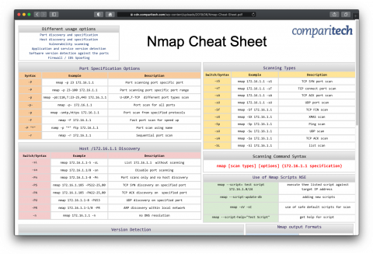
Nmap’s Learning Curve
Nmap is a relatively easy tool to use, but the amount of options can be overwhelming.
New users spend much of their time and effort looking up which flags do what

Slide 4
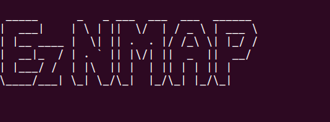
EzNmap
Easy to use python tool with options for command line usage or through a gui.
Helps users get the information they want without needing to memorize option flags.

Slide 5
Demo

Slide 6
Future development
Finish functionality for gui version
Add options for additional flags
Use results with vulnerability a database like exploit-db

